Slide 1
Your First Angular App

Slide 2


Slide 3
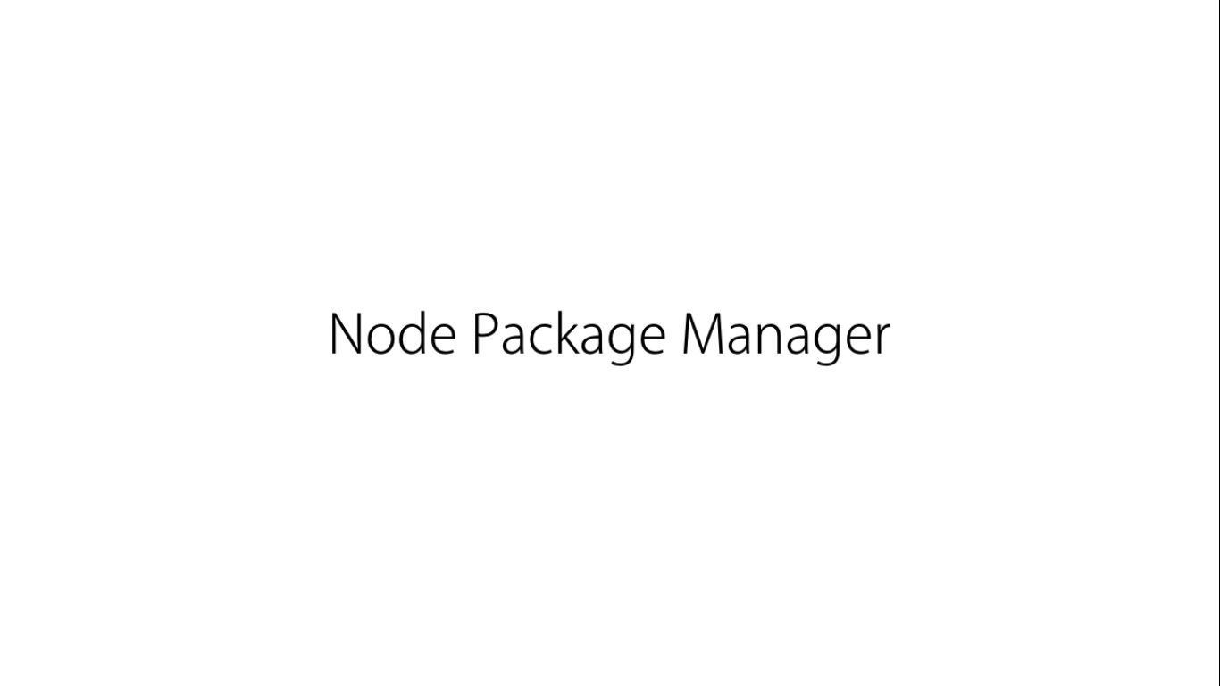

Slide 4
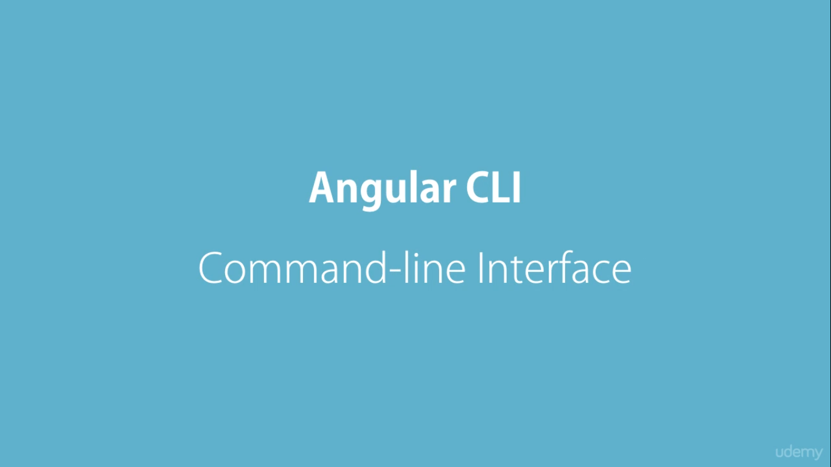

Slide 5
